Slide 1
TOPIC PIXELTALK
GROUP 16
TEACHER NAME: DR. ANOJ KUMAR
GROUP MEMBERS
1.KOMAL CHAURASIA(20164064)
2.KOMAL KHANDELWAL(20164100)
3.KRITHIKA VENKATANATH(20164129)
4.LOKESH KHANCHANDANI(20164010)
5.LOKESH KUMAR SINGH(20164068)

Slide 2
INTRODUCTION
The development of text reading device is still at an early stage.
Existing systems for text recognition are typically limited or may be of high cost.
Therefore we need a low cost system that will be able to automatically locate and read the text aloud to visually impaired persons.

Slide 3
PROBLEM STATEMENT
Real time implementaton of image recognition and text to speech conversion.
This project introduces an innovatve, efficient and real time cost beneficial technique that enables user to hear the contents of documents/text images instead of reading through them.
It combines the concept of Optical Character Recognition (OCR) and Text to Speech Synthesizer (TTS).

Slide 4
SOFTWARE AND HARDWARE REQUIREMENTS
SOFTWARE REQUIREMENTS:
Operating System: Windows / Linux
IDE: Android Studio 3.0
Languages: Java, XML
Java JDK 1.8 or higher
HARDWARE REQUIREMENTS:
CPU: Dual core Processor
RAM: 2GB or above
Android smartphone running android v5.0(Lollipop) or above

Slide 5
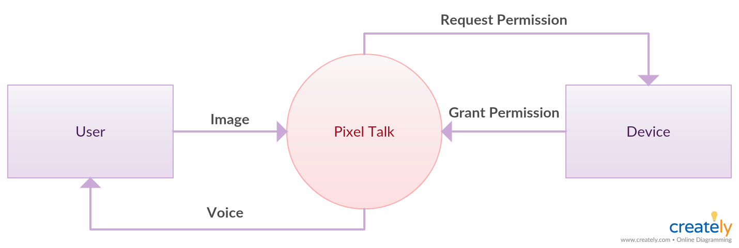
DESIGN

Slide 6
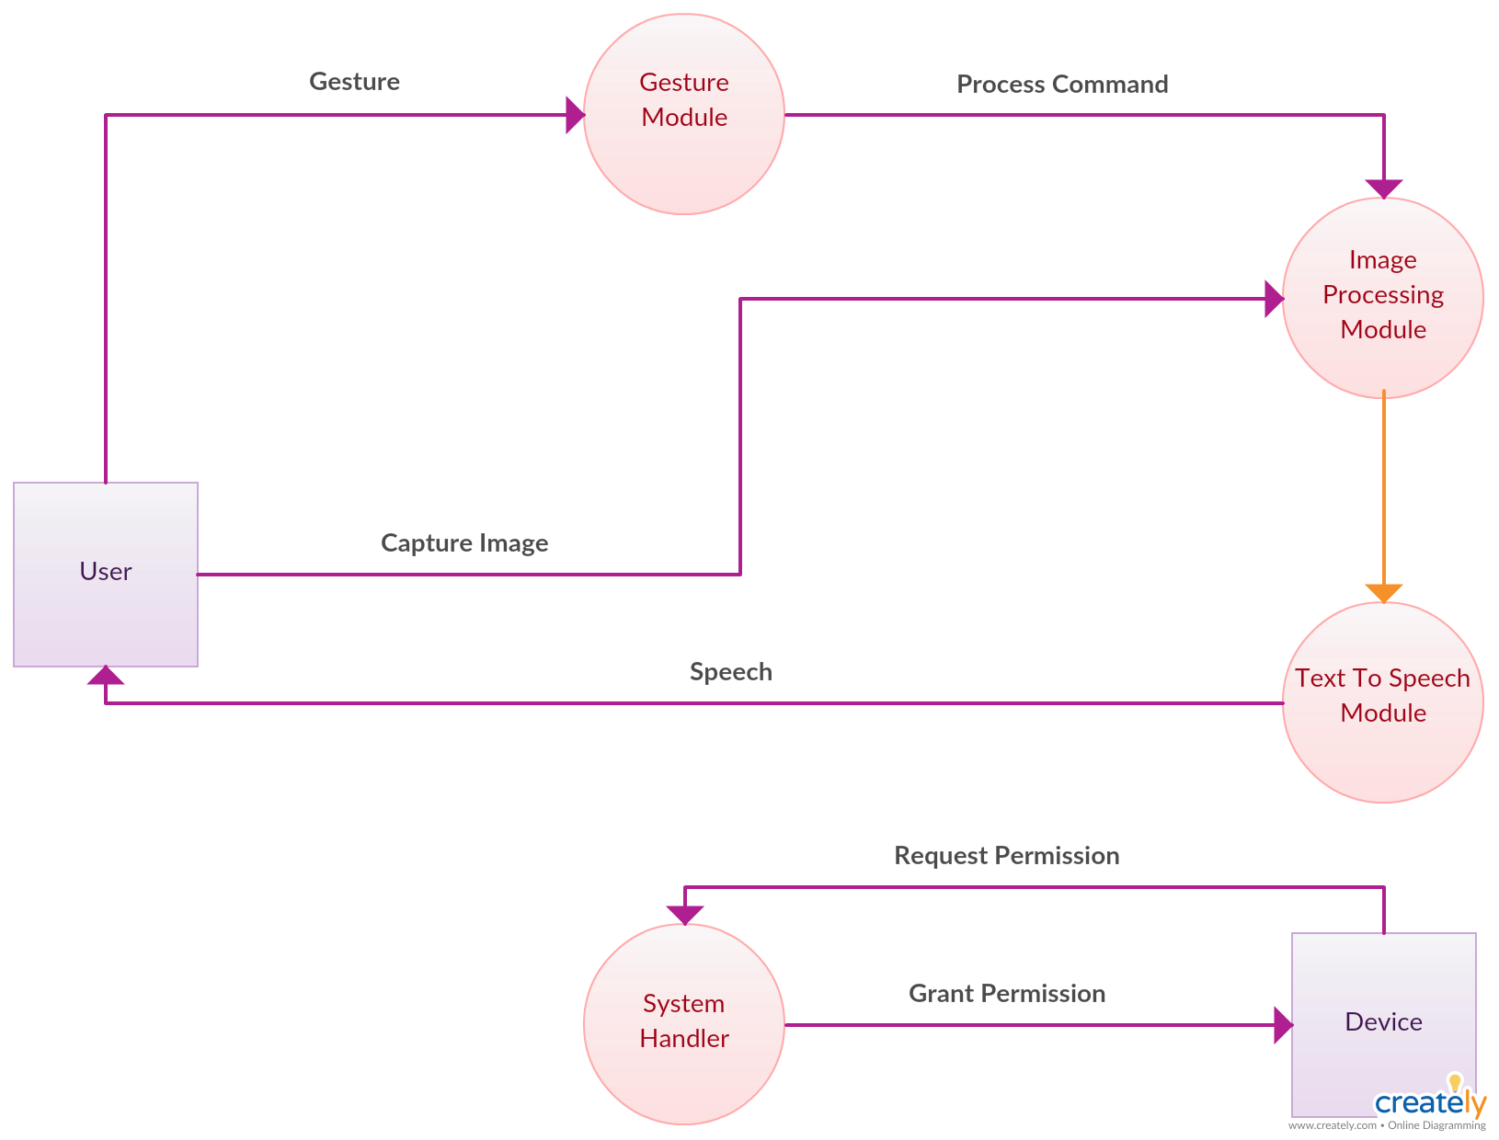

Slide 7
MODULES
User Interface-We will provide an easy to use GUI which will allow the user to interact to the system.
Image Processing-This Module involves acquiring text image from the smartphone camera and converting it into text using OCR.
Voice Processing-This Module uses Text to Speech Synthesizer for converting text document to speech.
Gesture Handling Module-The Module provides the facility to open the appalication by Gesture like shaking hand.

Slide 8
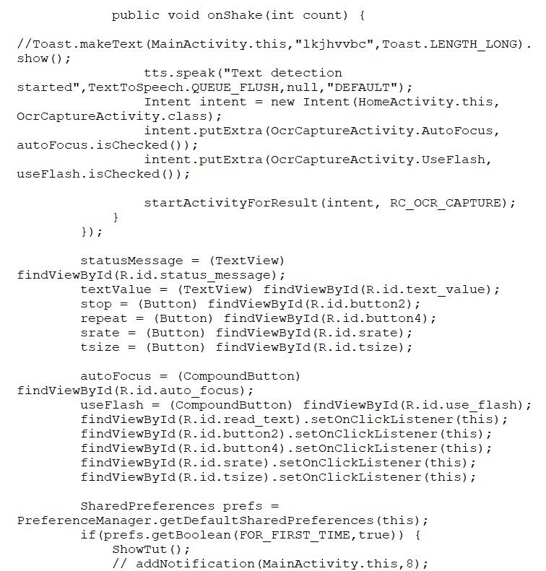
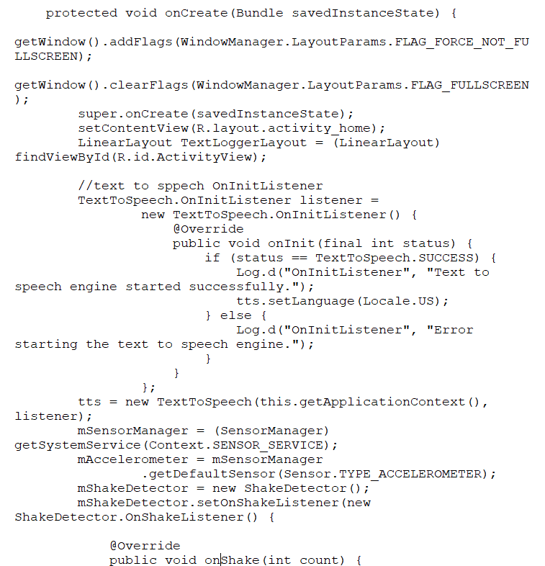
CODING

Slide 9



Slide 10
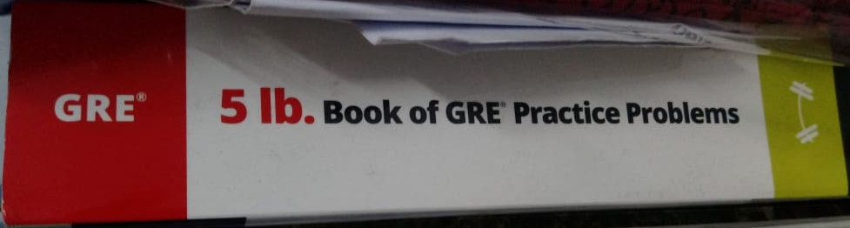
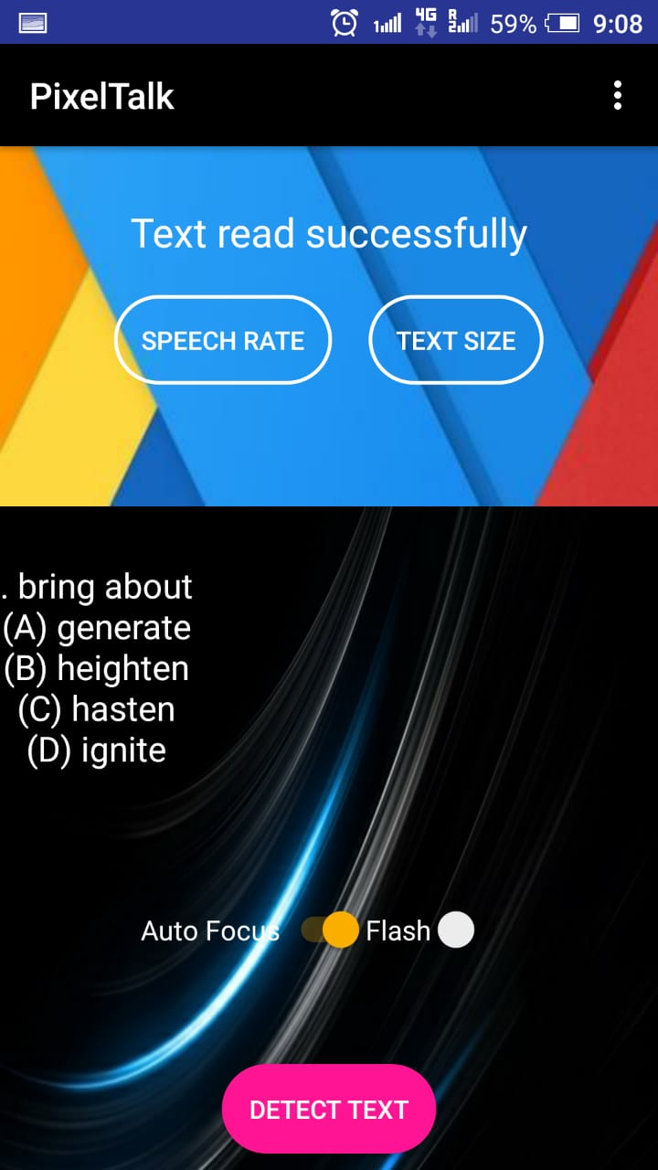
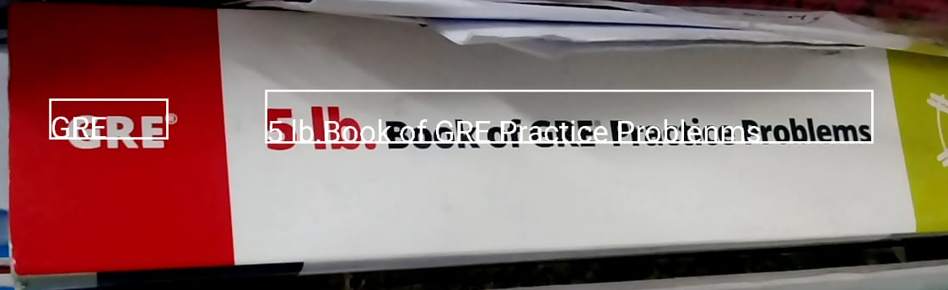
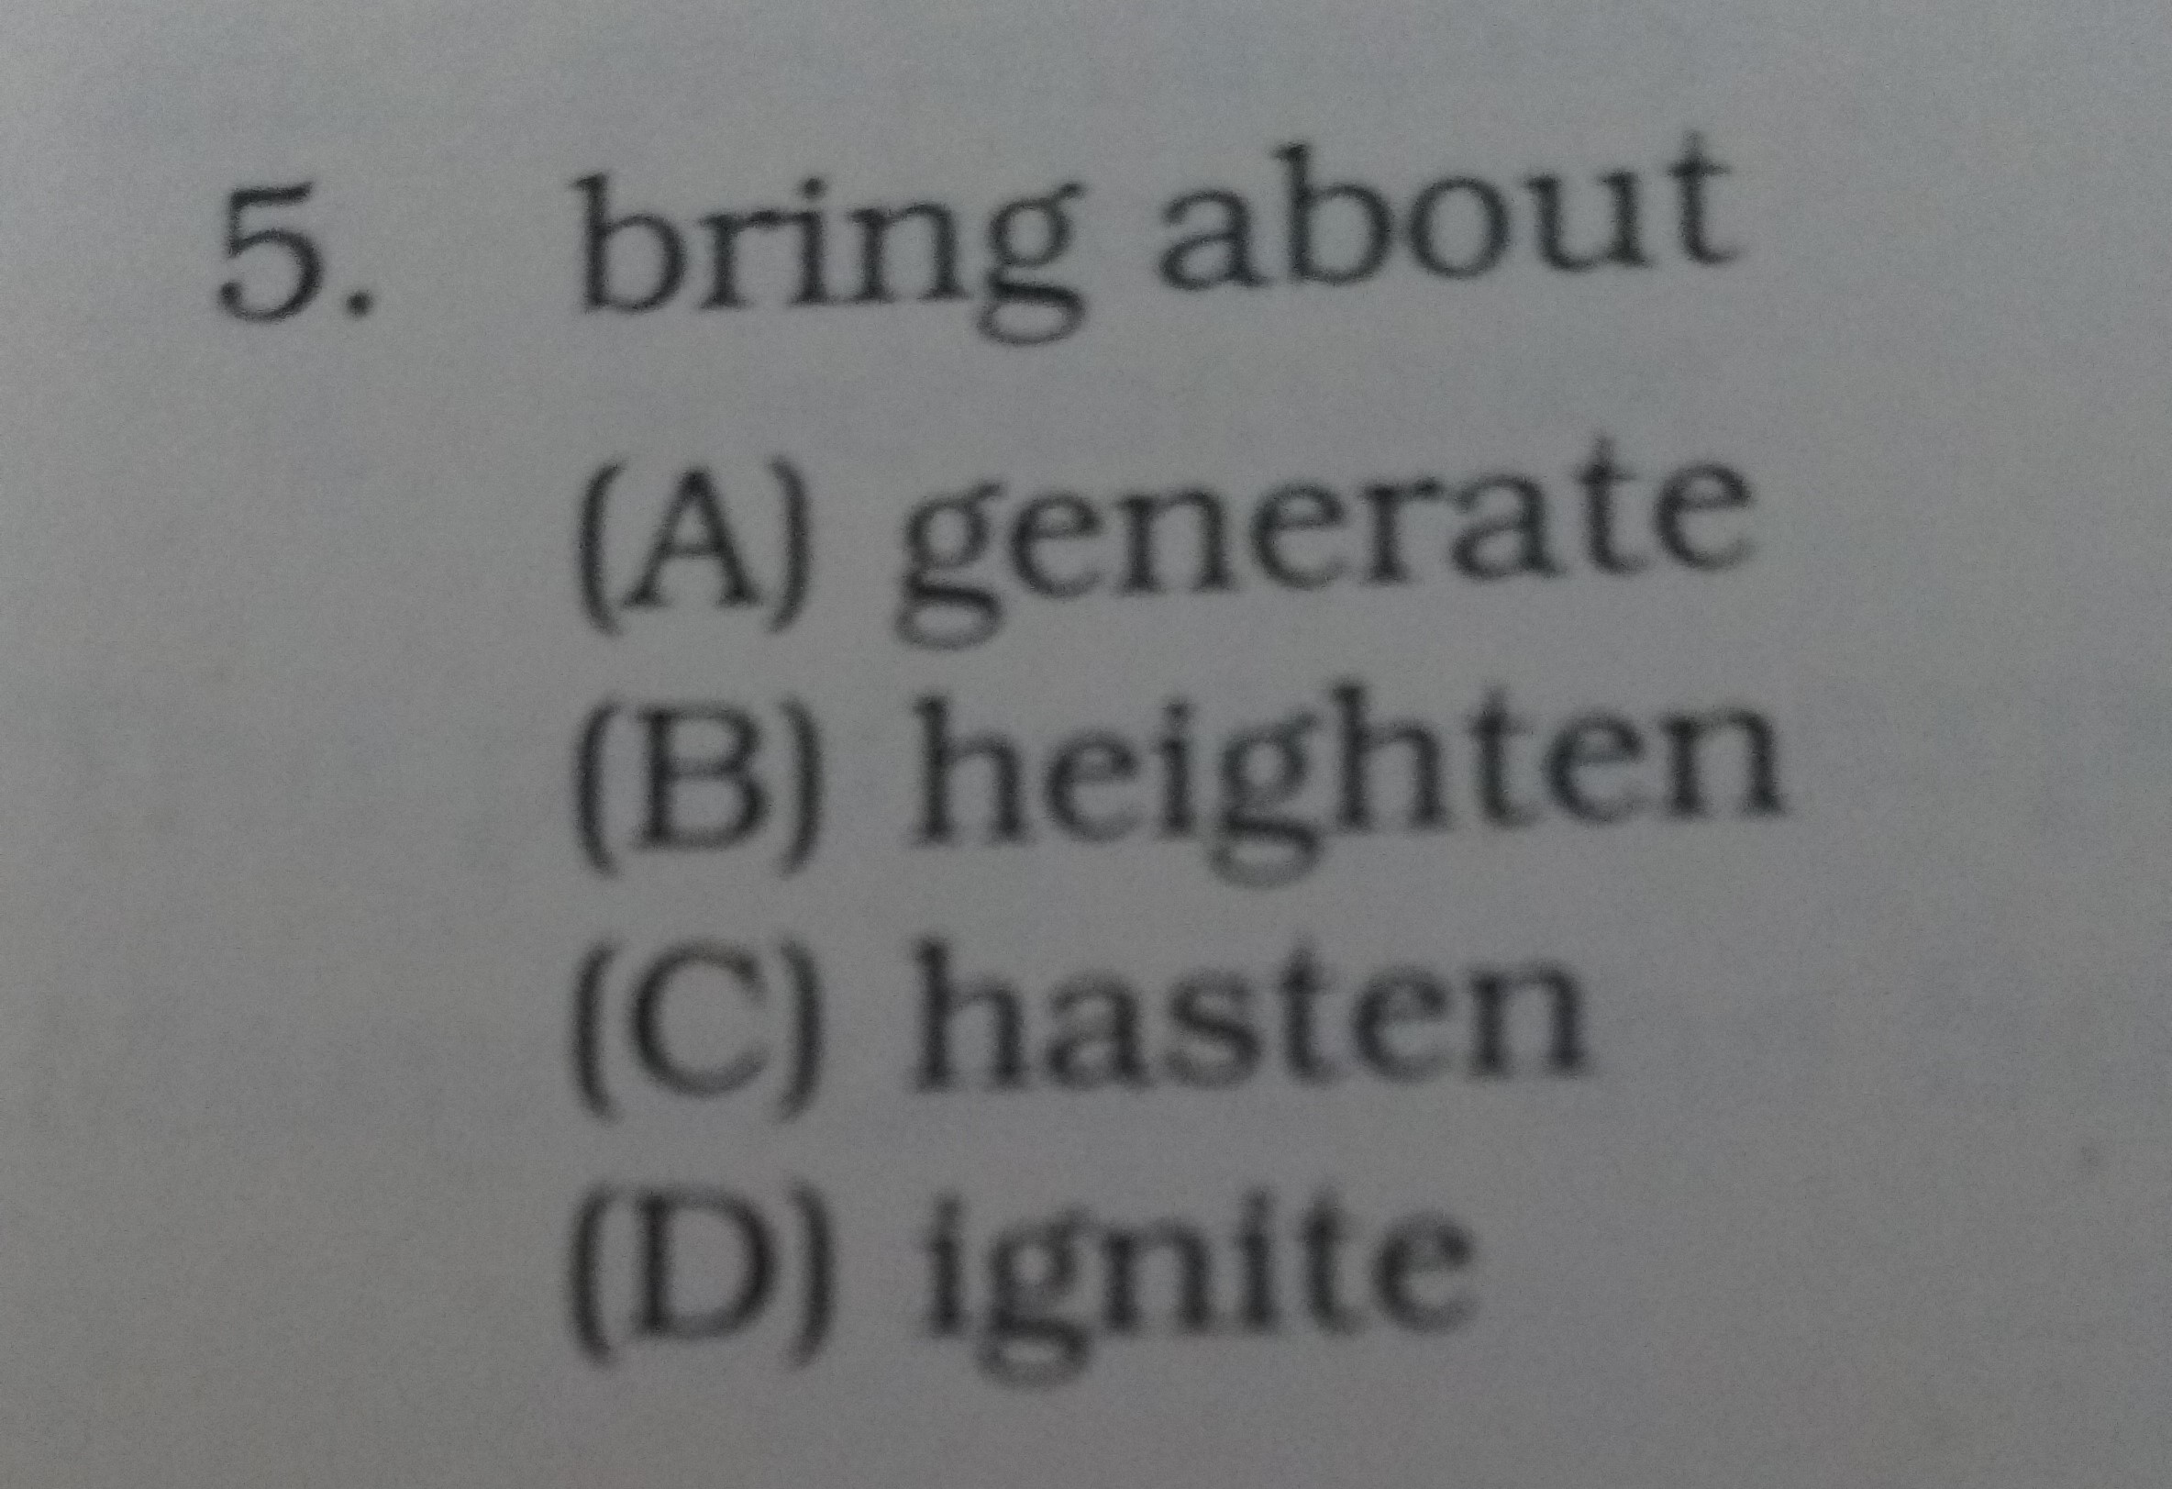
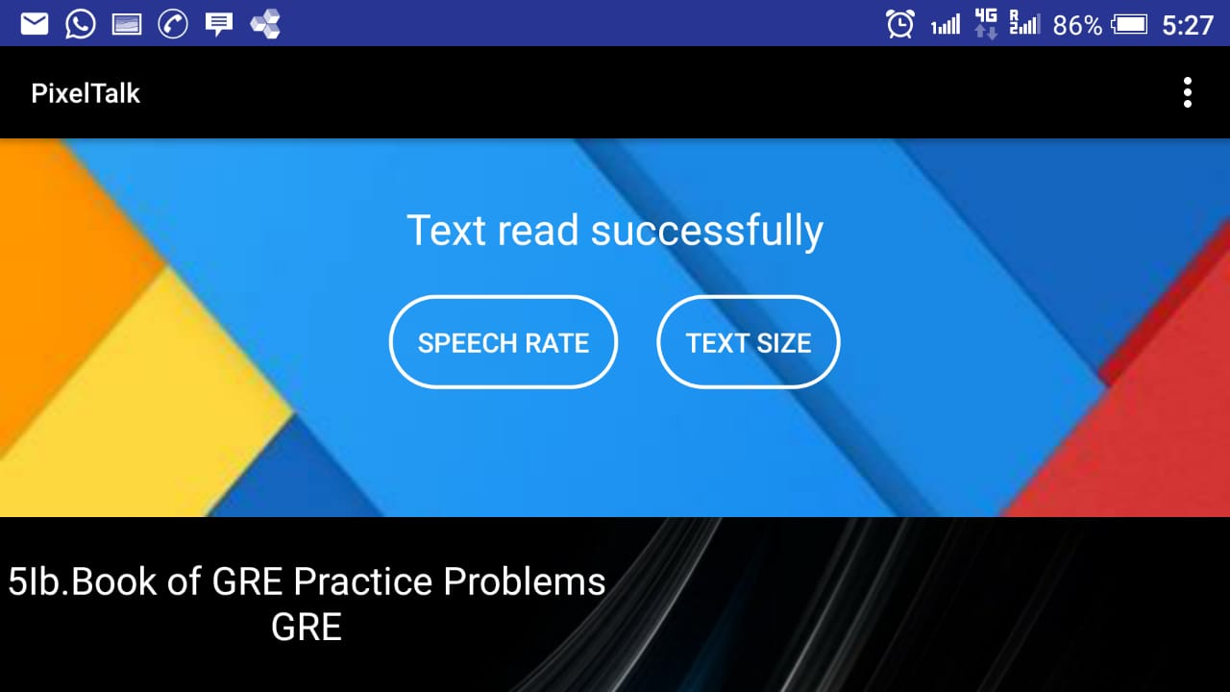
OUTPUT

Slide 11
TESTING
1. Text to Speech Module Testing
Naturalness Testing:
MOS is used for naturalness testing.Mean Opinion Score gives a numerical indication of the quality of the synthesized speech.In this method, focus of evaluator should be on naturalness of synthetic speech.
Accuracy Test:
Accuracy Test For accuracy calculation proper selection of test data is crucial. All such data whose expected output is well defined can be considered for accuracy test.

Slide 12
Comprehensibility Test:
In Comprehensibility test, evaluator will be asked to listen to a paragraph/story (100 – 150 words) and based on that a series of questions will be posed. Questions should be framed in such a way that whether the evaluator has understood the paragraph heard or not can be observed.
Segemental Testing:
MRT : Modified Rhyme Test
This test is to judge whether the evaluators can differentiate the rhyming words or not.
Difficult Word
Word containing one or more conjunct which are difficult to pronounce.

Slide 13
2.Image to Text Testing
Character Level Testing:
How accurate an OCR software is on a character level depends on how often a character is recognized correctly versus how often a character is recognized incorrectly. An accuracy of 99% means that 1 out of 100 characters is uncertain. While an accuracy of 99.9% means that 1 out of 1000 characters is uncertain.
Word Level Testing:
Here, we count how many words were recognized correctly . To test this, we consider the language of the tex that is used and compare the recognized words to the dictionary to check for uncertain characters with highest similarities to those in an existing word.

Slide 14
Checking Quality of the Image:
The image must have the following features to be of high quality
Sharp character borders
High Contrasts
Well aligned characters
Less pixel noise
Quality Testing:
We check the following criteria to maintain a good quality image
Scaling to the right size
Increase contrast
Convert multicolored image to grayscale image
Remove noise
Deskew the image

Slide 15
CONCLUSION AND FUTURE SCOPE
CONCLUSION
The modules used in the implementation of this project can be efficiently used to speed up the translation of image based documents into structured documents that are currently easy to discover, search and process into various forms such as speech.
FUTURE SCOPE
The recognition of new font characters.
Store the audio for reuse.
Automated entry of data into systems.
Convert all functions of the app into Voice-Over audio using TTS.

Slide 16
REFERENCES
https://codelabs.developers.google.com/codelabs/mobile-vision-ocr/
https://developer.android.com/reference/android/speech/tts/TextToSpeech
https://openid.net/specs/openyolo-android-03.html
https://developer.android.com/training/gestures/
https://developer.android.com/guide/topics/ui/look-and-feel/

